Slide 1


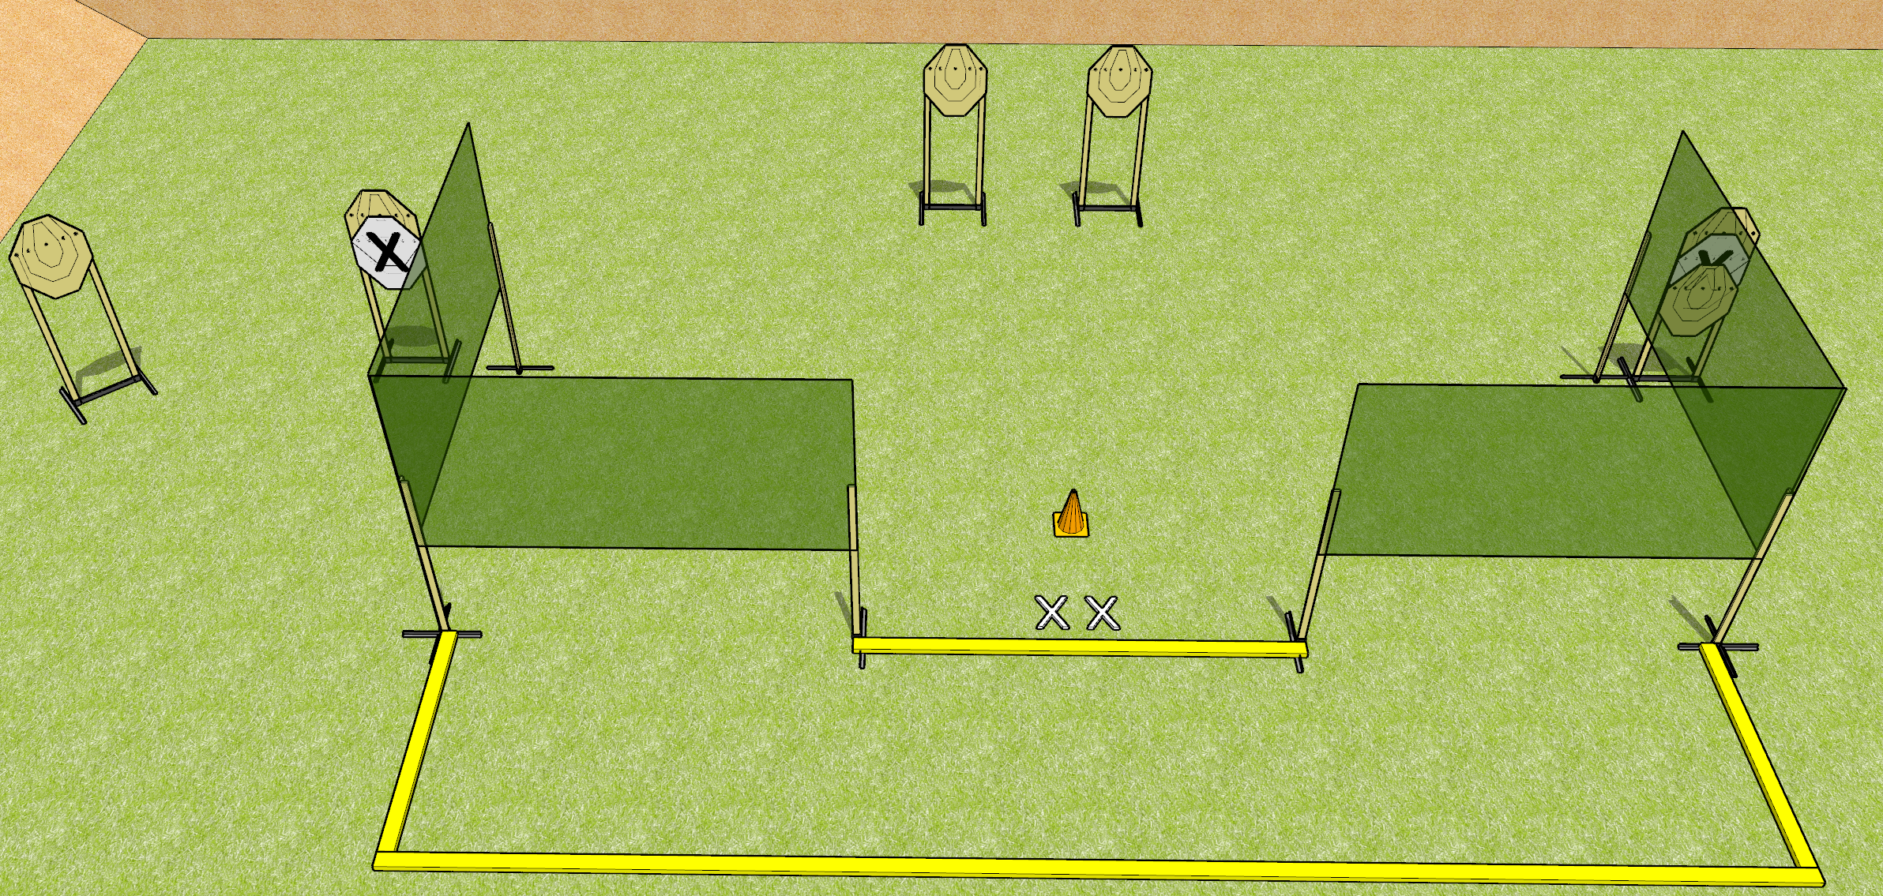
 | Dothan Gun Club – USPSA Match Turtle Standards Course Designer : Drew Coleman
START POSITION : Standing with both feet on X’s. Hands relaxed at sides.
GUN READY CONDITION : Pistol loaded and holstered. PCC shouldered, safety on, pointed at orange cone. |  | SCORING: Virginia Count, 24 rounds TARGETS: 6 paper, 0 Steel SCORED HITS: Best 4 on paper, steel until down START-STOP: Audible, last shot RULES: Failure to perform a mandatory reload will be a procedural per shot fired. Failure to fire strong hand only will be a penalty per shot fired.
STAGE PROCEDURE: String 1: upon start signal, engage each target with 1 round only from within the fault lines, perform a mandatory reload, then reengage each target with 1 round only. String 2: upon start signal, engage each target with 1 round only from within the fault lines, perform a mandatory reload, then reengage each target with 1 round only strong hand only.

